Slide 1
Marketing Electric Vehicles
Catherine Hutt
Society of Motor Manufacturers and Traders
chutt@smmt.co.uk

Slide 2
Marketing electric vehicles:
Brief introduction to Catherine/ SMMT
The learning curve
Message 1: Stages of the learning curve
Message 2: Benefits, not features
Message 3: Experiential marketing
Working together to enable the EV market

Slide 3
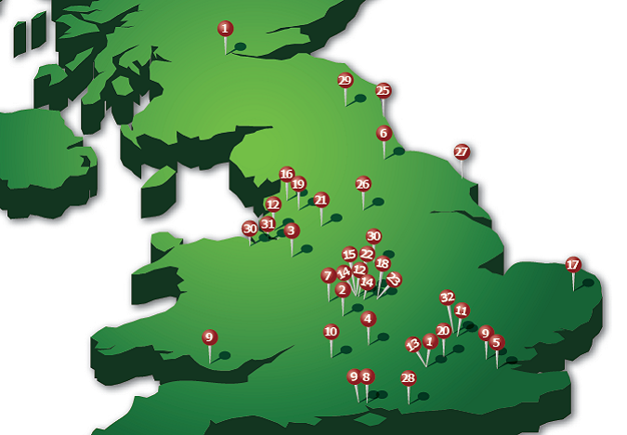
SMMT:
Voice of the automotive industry
Recently formed EV Group
Six key areas for the EV Group
Our mission:
“To encourage and promote, in the UK and abroad, the interests of the motor industry”

Slide 4
The learning curve:
EV basics
Operational questions
Buying criteria
Deal or no deal
Attention
Interest
Desire
Action
Notes:
EV Basics:
What is an EV?
Are there any on the market?
Do they do what I want them to do?
Operational questions:
Range, speed, capacity
Where/ how do I charge it?
What does it feel like to drive?
Buying criteria:
Price → Additional benefits (free parking? Congestion charge?)
Image: Is there any value added? Commercial/ personal value? (eg Pruis vs Honda)
Warranty/ Safety/ running cost/ servicing/ charger installation/ RVs
Creature comforts (iPhone doc/ gadgets...)
Battery recycling

Slide 5
Message 1: Stages of the learning curve
A
I
D
A
Attention: EV basics
What is an EV?
Are there any on the market?
Does an EV do what I want it to do?

Slide 6
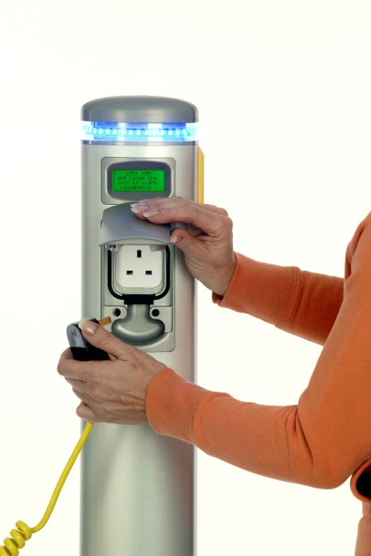
Message 1: Stages of the learning curve
A
I
D
A
Interest: Operational questions
Range, speed, capacity
Where/ how do I charge it?
Charger installation
Can the grid cope?
Notes:
Range: Milkfloat vs

Slide 7
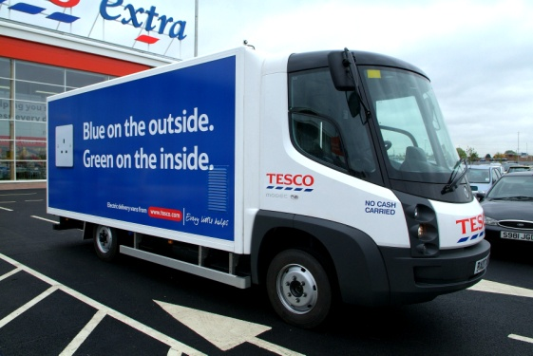
Message 1: Stages of the learning curve
A
I
D
A
Desire: Buying criteria (emotional)
Price: Additional benefits?
Image: Is there any value added?
What does it feel like to drive?
Creature comforts (iPhone doc/ gadgets...)
Warranty, running cost, servicing, RVs
Battery recycling
Notes:
Price: © charge? Parking? Free road tax?
Image: Prius vs Honda – some will pay for perceived value
BILLBOARD value
Chargers: Where? When? Operational implications? How much? Can I retro-fit? Why now if better products are coming onto the market?
Grid: Household 1-phase, not 3-phase. Worse in the US. But: 31m vehicles, 50% Evs, 10% uptake in 10-15 yrs, so 1.5m by 20-25, plus 90% in 10-15 yrs, so 13-14m by 2040 … grid will be updated by then
Warranty etc: RVs have a role to play, that’s why we don’t buy fluorescent cars (Clarkeson), functional aspect moves up the agenda
Creature comforts:

Slide 8
Message 1: Stages of the learning curve
A
I
D
A
Action: To buy or not to buy?
All previous questions put together
Notes:
This is the hard part: you can lead a horse to water but you can’t make it drink…
Takes time and consistent messaging (industry brand required… even repositioning)
NB: Difference between countries;
UK = milk float stereotype
Europe = EV understanding & acceptance
US = 180’ turnaround since 2006

Slide 9
Message 2: Benefits, not features
Features
(Explain)
Benefits
(Win hearts and minds)
Range
Acceleration
Seating capacity
Quiet, smooth drive
Personal image
Gadgets/ luxuries
Low running costs
Ideal for commuting
Reduce personal CO₂

Slide 10
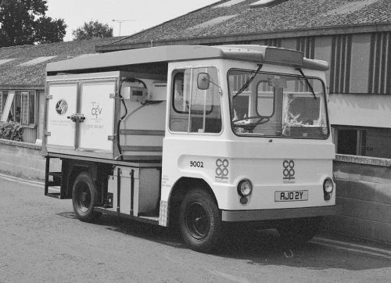
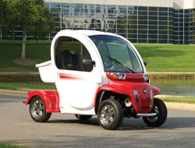
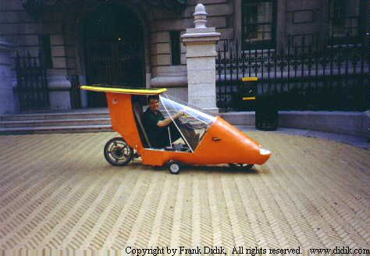
The EVs of yesterday:

Slide 11
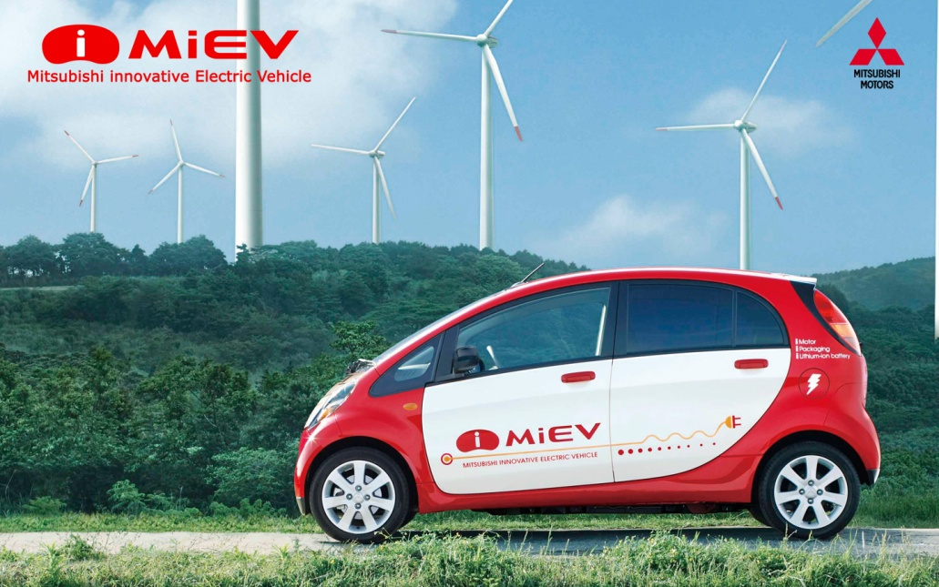
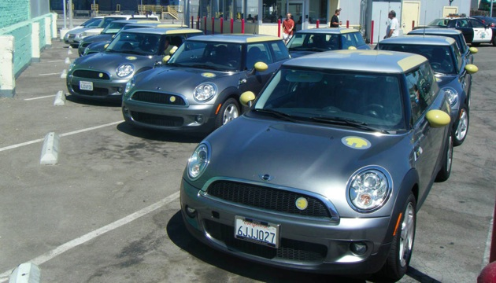
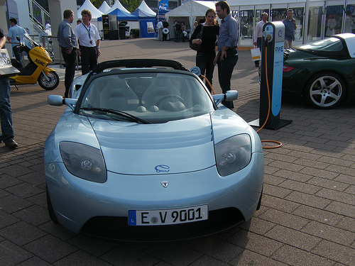
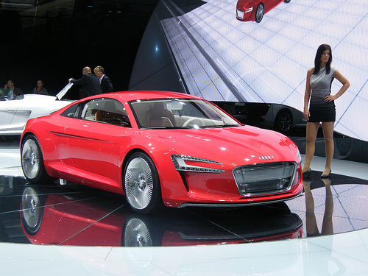
The EVs we see today:

Slide 12
Message 3: Experiential Marketing
Speed up the learning curve
Change perception: Win hearts and minds
Don’t forget the new generation
Look for suitable operations for the stage in the life cycle
Notes:
Suitable operations: buyer behaviour changes...
Early adopters: Car sharing schemes? Public sector fleets? (no vehicle choice)
Early majority: Private hire vehicles? Company car fleets? (some choice of vehicles)
Late majority: Joe Public (infinite choice of vehicles)
Laggards:

Slide 13
Message 3: Experiential Marketing

Slide 14
Marketing electric vehicles:
Brief introduction to Catherine/ SMMT
The learning curve
Message 1: Stages of the learning curve
Message 2: Benefits, not features
Message 3: Experiential marketing
Working together to enable the EV market

Slide 15
Potential uptake of EVs in the UK:
0% of
established market but 50% potential of all journeys
2m cars bought each year
Notes:
EV Basics:
What is an EV?
Are there any on the market?
Do they do what I want them to do?
Operational questions:
Range, speed, capacity
Where/ how do I charge it?
What does it feel like to drive?
Buying criteria:
Price → Additional benefits (free parking? Congestion charge?)
Image: Is there any value added? Commercial/ personal value? (eg Pruis vs Honda)
Warranty/ Safety/ running cost/ servicing/ charger installation/ RVs
Creature comforts (iPhone doc/ gadgets...)
Battery recycling

Slide 16
Adoption rates:
0% of
established market but 50% potential of all journeys
10% of established market
= 200,000 EVs?
90% of established market
= 1.8m Evs?
Notes:
EV Basics:
What is an EV?
Are there any on the market?
Do they do what I want them to do?
Operational questions:
Range, speed, capacity
Where/ how do I charge it?
What does it feel like to drive?
Buying criteria:
Price → Additional benefits (free parking? Congestion charge?)
Image: Is there any value added? Commercial/ personal value? (eg Pruis vs Honda)
Warranty/ Safety/ running cost/ servicing/ charger installation/ RVs
Creature comforts (iPhone doc/ gadgets...)
Battery recycling

Slide 17
Working together to enable the EV market:
Incentives
Word of mouth
High profile advocates
Media coverage
Product marketing
Attention
Interest
Desire
Action
Repositioning and Myth busting required!
Focus on emotional aspects
Notes:
Tipping points only work if a sequence of events comes together
Call for all stakeholders to work together to achieve the common goal
Without it neither government nor industry will achieve their aims

Slide 18
Final thoughts:
The learning curve isn’t optional
Success will depend on how quickly everyone can complete the learning curve
Bums on seats = vehicles sold
United we stand, divided we fall
Thank you for listening

Slide 19
Marketing Electric Vehicles
Catherine Hutt
SMMT
chutt@smmt.co.uk

